Slide 1
Classical vs Post-Quantum Cryptography
CSIT 567 | Spring 2026
Allison Buckingham and Faith Puppala

Slide 2
Introduction
▸ Quantum computers pose an existential threat to cryptography as we know it today
Even now attackers are gathering encrypted data to decrypt once quantum computers become mainstream.
2030? 2050? 2063 (year of first contact in Star Trek)
▸ Current asymmetric cryptographic standards (RSA, ECC) rely on integer factorization which is compromised by quantum machines
▸ Post-Quantum Cryptography (PQC) offers quantum-resistant alternatives
▸ We examined the performance differences between classic and post-quantum cryptography

Slide 3
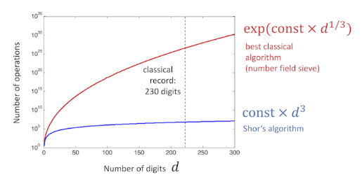
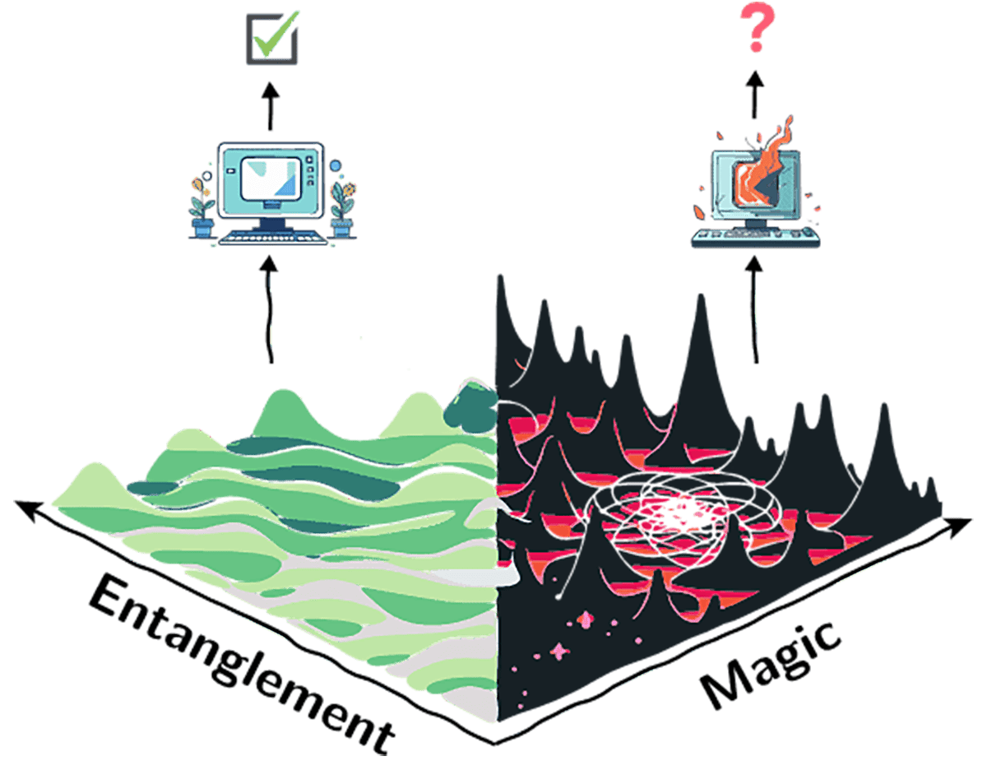
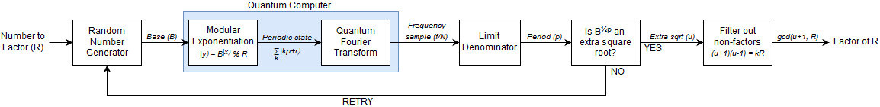
Shor’s Algorithm
▸ Shor's algorithm provides exponential speedup for integer factorization
Ref: Shor-s-Algorithm/Shor.ipynb at master · mett29/Shor-s-Algorithm · GitHub

Slide 4
Classic Cryptography
▸ Asymmetric (Public-Key): RSA, DSA, ECDSA, ECDH
▸ Security based on integer factorization & discrete logarithm problems
▸ Foundation of modern TLS/HTTPS infrastructure
▸ Vulnerability to quantum computing represents a fundamental architectural risk
▸ Symmetric (AES , ChaCha20, Twofish, 3DES) is not vulnerable to quantum computers

Slide 5
Classic Cryptography Used in Project
▸ For digital signatures we used Elliptic Curve Digital Signature Algorithm (ECDSA)
▸ Dominant standard for TLS certificates, cryptocurrencies, mobile platforms
Include python package details here
▸ For key exchange we used Elliptic Curve Diffie-Hellman (ECDH)
▸ Foundation of TLS 1.3 handshake mechanism
Include python package details here

Slide 6
Post-Quantum Cryptography Used in Project
▸ For digital signatures we used ML-DSA: Module-Lattice Digital Signature Algorithm
▸ NIST Standard: FIPS 204 (approved 2024)
Include python package details here
▸ For key encapsulation we used ML-KEM: Module-Lattice Key Encapsulation Mechanism
▸ Key exchange calculates a shared secret collaboratively, while KEM generates a secret on one side and "encapsulates" (encrypts) it using the recipient's public key
Include python package details here

Slide 7
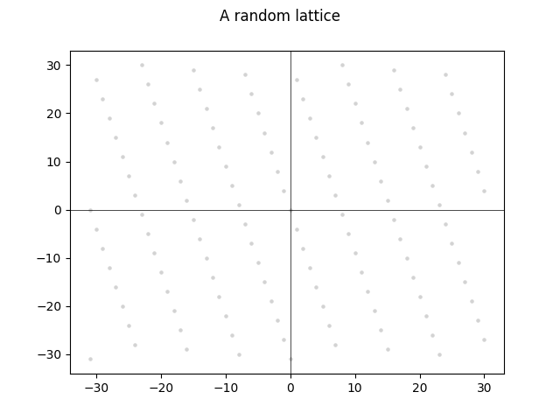
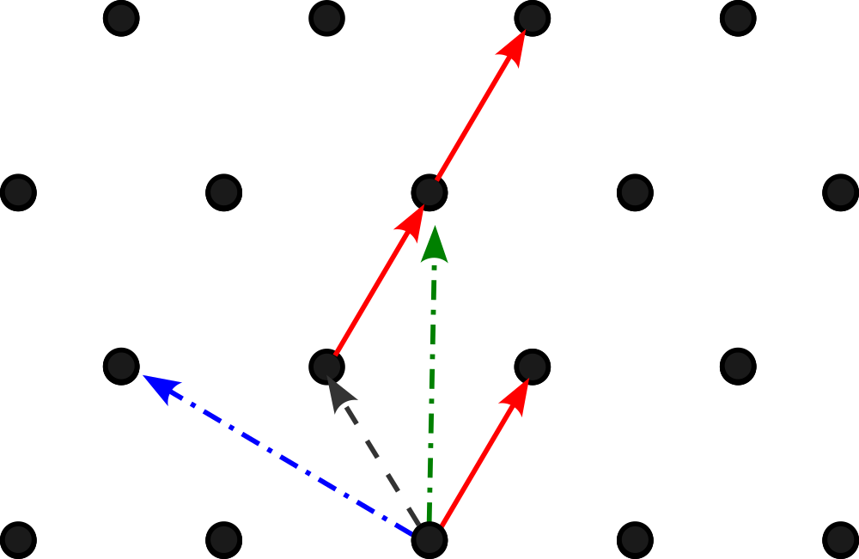
Post-Quantum Cryptography
▸ Post Quantum Cryptography is based on hard lattice problems believed resistant to quantum attack
▸ A lattice is an infinite grid of points in high-dimensional space.
A two-dimensional lattice might look something like this.
▸ The security relies on problems like the Shortest Vector Problem (SVP)
▸ “Noise“ is moving slightly off the exact lattice point.

Slide 8
Benchmark Results: Artifact Sizes
Classical (ECDSA/ECDH)
ECDSA Signature: 70 bytes
ECDSA Public Key: 91 bytes
ECDH Public Key: 91 bytes
Post-Quantum (ML-DSA/ML-KEM)
ML-DSA Signature: 2,420 bytes
ML-DSA Public Key: 1,312 bytes
ML-KEM Ciphertext: 1,088 bytes
ML-KEM Public Key: 1,184 bytes

Slide 9
Benchmark Results: Operation Times (30 runs)
Classical (ECDSA/ECDH)
ECDSA: Keygen 0.12ms | Sign 0.28ms | Verify 0.08ms
ECDH: Keygen 0.02ms | Exchange 0.09ms
Post-Quantum (ML-DSA/ML-KEM)
ML-DSA: Keygen 3.63ms | Sign 18.73ms | Verify 4.29ms
ML-KEM: Keygen 2.05ms | Encaps 2.67ms | Decaps 3.65ms

Slide 10

Demo of Comparison Site

Slide 11
Implementation Challenges
▸ PQC certificates ~40x larger than classical (~160KB vs ~4KB)
▸ Network overhead impacts handshake latency
▸ Quote: 'The bigger you make the certificate, the slower the handshake...' — Bas Westerbaan, Cloudflare
▸ Risk of user abandonment if perceived performance degradation
▸ Backward compatibility requirements complicate migration

Slide 12
Industry Solutions & Adoption
▸ Merkle Tree Certificates: Efficient verification of large datasets
▸ Google's Quantum-Resistant Root Store: ML-DSA in Chrome production
▸ Cloudflare pilot: ~1,000 PQC-enabled certificates deployed
▸ Hybrid key exchange: Immediate quantum resistance via dual algorithms
▸ CAs preparing for full PQC certificate generation

Slide 13
Security Analysis
▸ Defense in Depth: Attacker must compromise BOTH classical AND PQC
▸ Harvest Now, Decrypt Later: Current encrypted data vulnerable in future
▸ Lattice problems believed to resist all known quantum algorithms
▸ Projected transition timeline: 10-15 years for full adoption
▸ Hybrid systems provide transitional quantum resistance

Slide 14
Conclusion
▸ PQC is essential for long-term cryptographic security
▸ Measured trade-off: 35x size increase, 10-60x slower operations
▸ Real-world deployment accelerating (Google, Cloudflare, NIST)
▸ Hybrid approach provides immediate protection during transition
▸ Proactive adoption necessary to protect sensitive data

Slide 15
References & Acknowledgments
▸ NIST FIPS 204: Module-Lattice-Based Digital Signatures (2024)
▸ Google Security Blog: Quantum-Resistant HTTPS Certificates
▸ Cloudflare Research: Post-Quantum TLS Deployment
▸ Ars Technica: 'Google is using clever math to quantum-proof HTTPS' (2026)
▸ Benchmark data collected using dilithium-py and kyber-py libraries

Slide 16
Questions?
Thank you!

